Slide 1

OOP
Object Oriented Programming
Lecture 17
Lecture 1

Slide 2
Quick Recap of inheritance and its types

Slide 3
Inheritance in C++
Reusability is a very impoprtant feature of OOPs
In C++, we can reuse a class and add additional features to it
Reusing classes saves time and money
Reusing already tested and debugged class will save a lot of effort of developing and debugging the same thing again

Slide 4
What is Inheritance in C++
The concept of reusability in C++ is supported using inheritance
We can reuse the properties of an existing class by inheriting from it
The exisiing class is called the Base Class
The new class which is inherited is called the Derived class
Reusing classes saves time and money
There are different types of inheritence in C++

Slide 5
Forms of Inheritance in C++
Single Inheritance
Multiple Inheritance
Hierarchical Inheritance
Multilevel Inheritance
Hybrid Inheritance

Slide 6
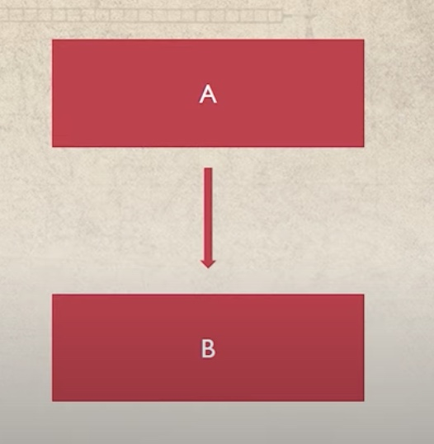
Single Inheritance
A derived class with only one base class
Notes:
person -> student

Slide 7
Example of Single Inheritance
class Person { //Base Class
public:
string name;
int age;
};
class Student : public Person { //Derived class
public:
int rollno;
};

Slide 8
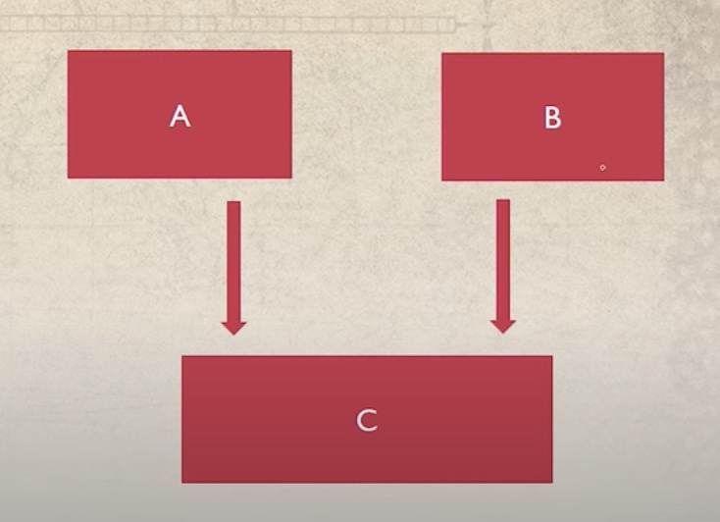
Multiple Inheritance
A derived class with more than one base class

Slide 9
Example of Multiple Inheritance
class Student { //Base Class
public:
string name;
int rollno;
};
class Teacher { //Base Class
public:
string subject;
double salary;
};
class TA : public Student, public Teacher { //Derived class
public:
int rollno;
};

Slide 10
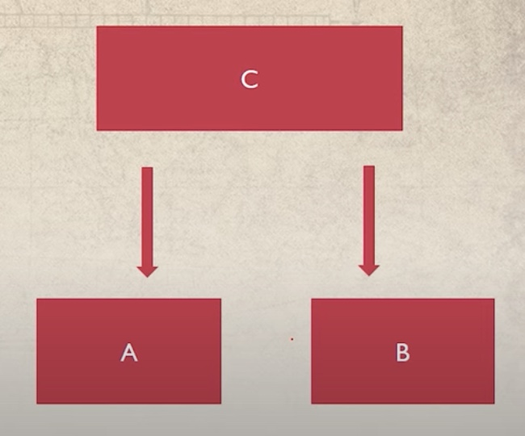
Hierarchical Inheritance
Several derived classes from a single base class

Slide 11
Example of Hierarchical Inheritance
class Person { //Base Class
public:
string name;
int age;
};
class Student : public Person { //Derived class
public:
int rollno;
};
class Teacher : public Person { //Derived class
public:
string subject;
double salary;
};

Slide 12
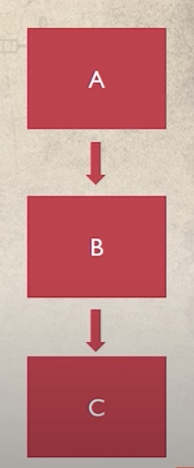
Multilevel Inheritance
Deriving a class from already derived class

Slide 13
Example of Multilevel Inheritance
class Person { //Base Class
public:
string name;
int age;
};
class Student : public Person { //Derived class
public:
int rollno;
};
class GradStudent : public Student { //Derived class
public:
string researchArea;
};

Slide 14
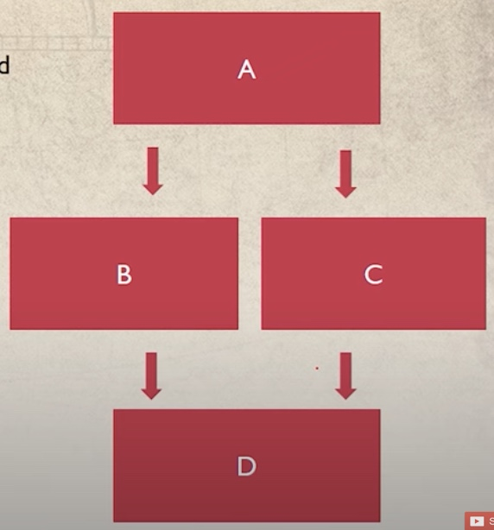
Hybrid Inheritance
Hybrid inheritance is a combination of multiple and multilevel inheritance

Slide 15
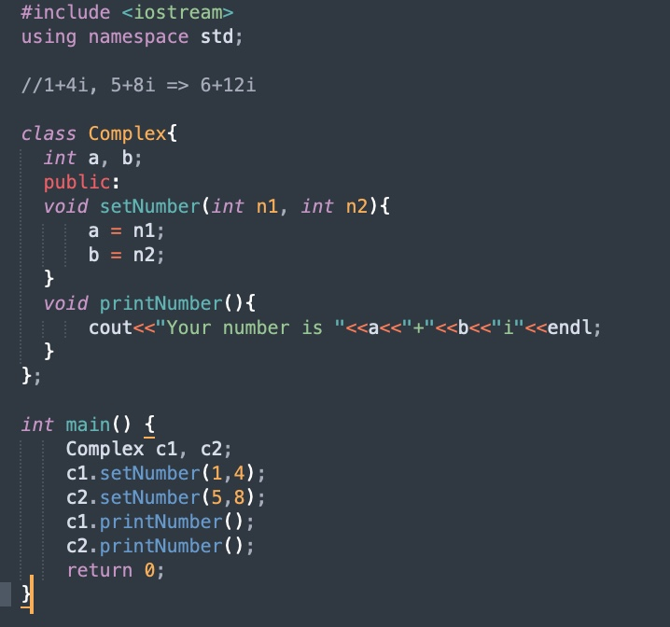
Friend Function in C++
Notes:
Task 1 contains the code of this

Slide 16
What is the output if i make the changes mentioned in the next slide?

Slide 17
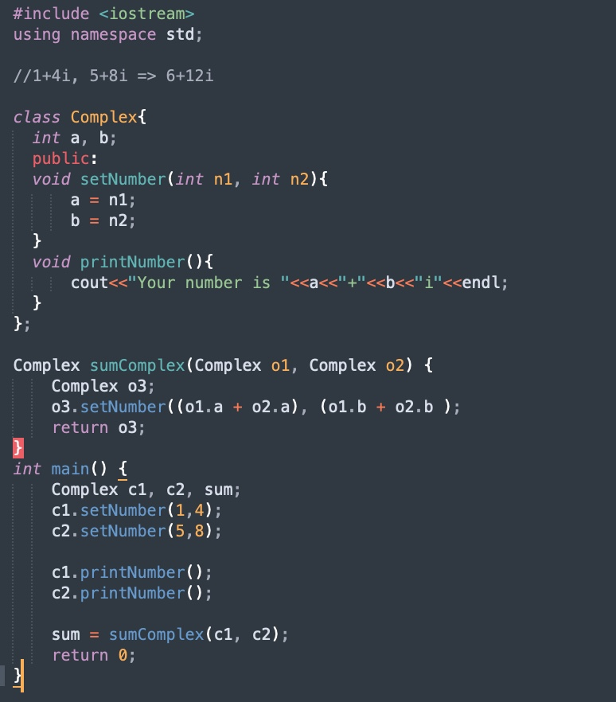

Slide 18
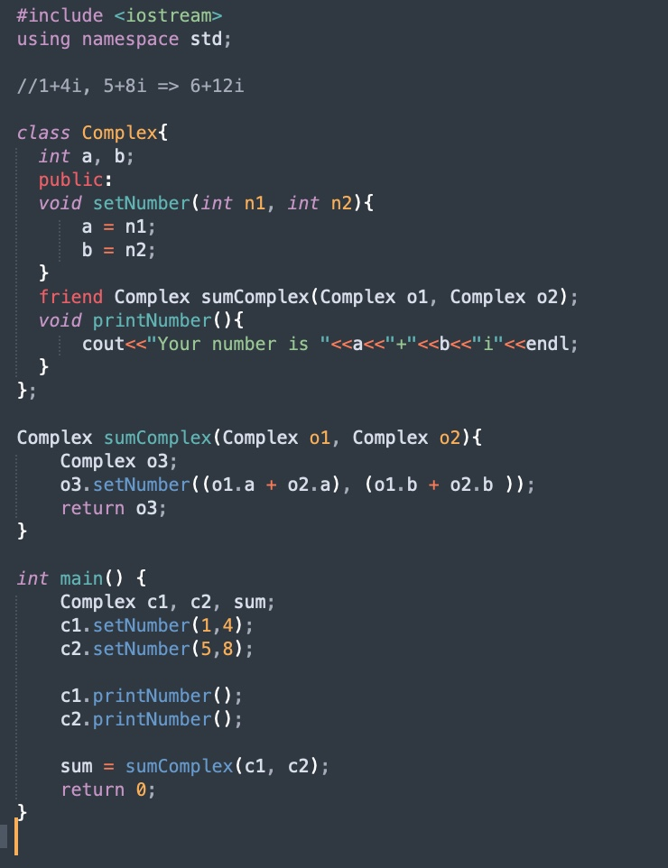
Solution

Slide 19
Properties of Friend Function
Not in the scope of class
Since it is not in the scope of the class, it cannot be called from the object of that class, i.e., c1.sumComplex() == invalid
Can be invoked without the help of any object
Usually contains the arguments as the objects
Can be declared inside the private or public section of the class
It cannot access the members by their names

Slide 20
End of Lecture

